Slide 1
Fragment Lifecycle Along with Activity
Name : Fahema Sultana
ID : 1711593042
Course : Cse486
Section : 01
Semester: Summer 2021

Slide 2
Activity Lifecycle Methods
onCreate()
onStart()
onResume()
onPause()
onStop()
onDestroy()

Slide 3
Fragments Lifecycle Methods
onAttach()
onCreate()
onCreateView()
onActivityCreated()
onStart()
onResume()
onPause()
onStop()
onDestroyView()
onDestroy()
onDetach()

Slide 4
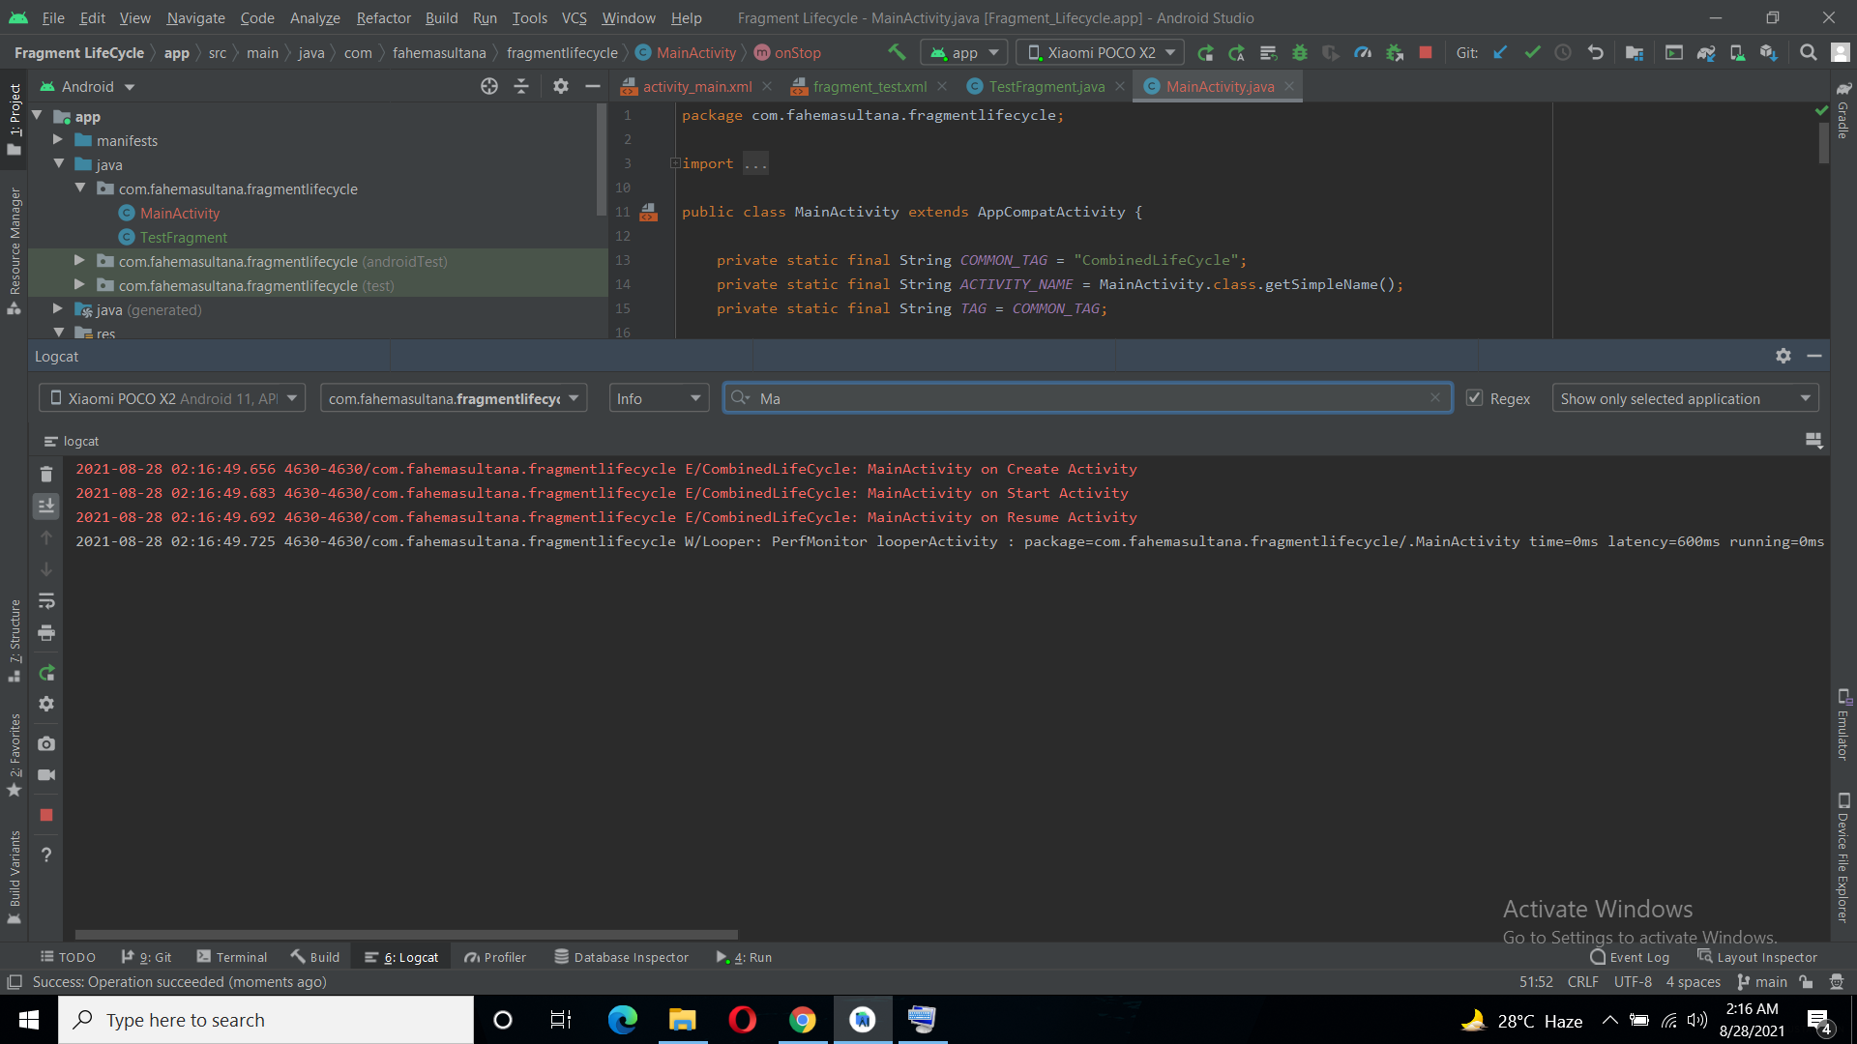
When App is Running Show Activity Methods

Slide 5
Details of previous Slide
From previous screen shot we can see when single activity running onCreate(), onStart() And onResume() method had been called.

Slide 6
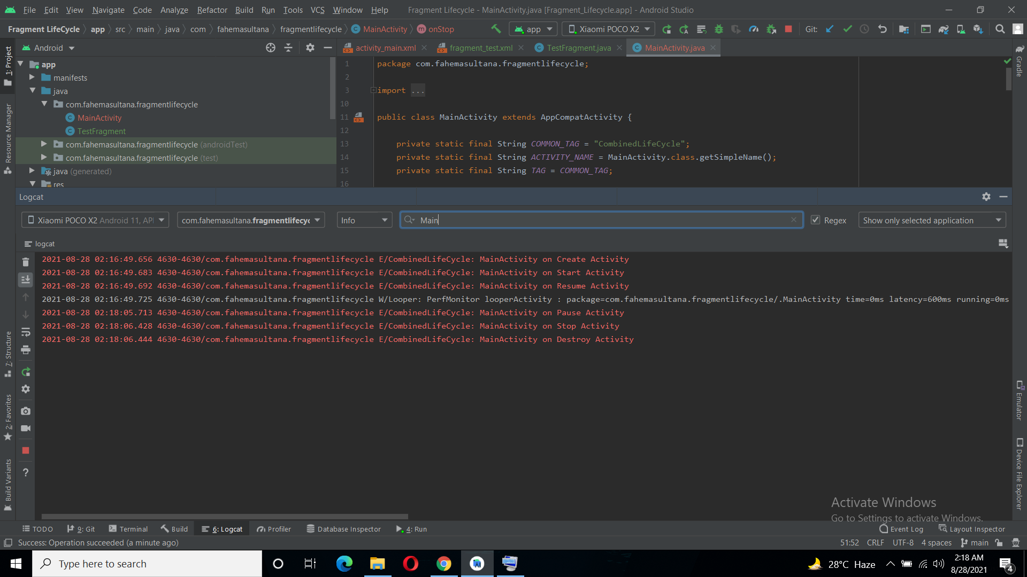
When Stop the App Show Activity Method

Slide 7
Details of previous Slide
From previous screen shot we can see when stop the App onPause() , onStop(),
onDestroy() method had been called.

Slide 8
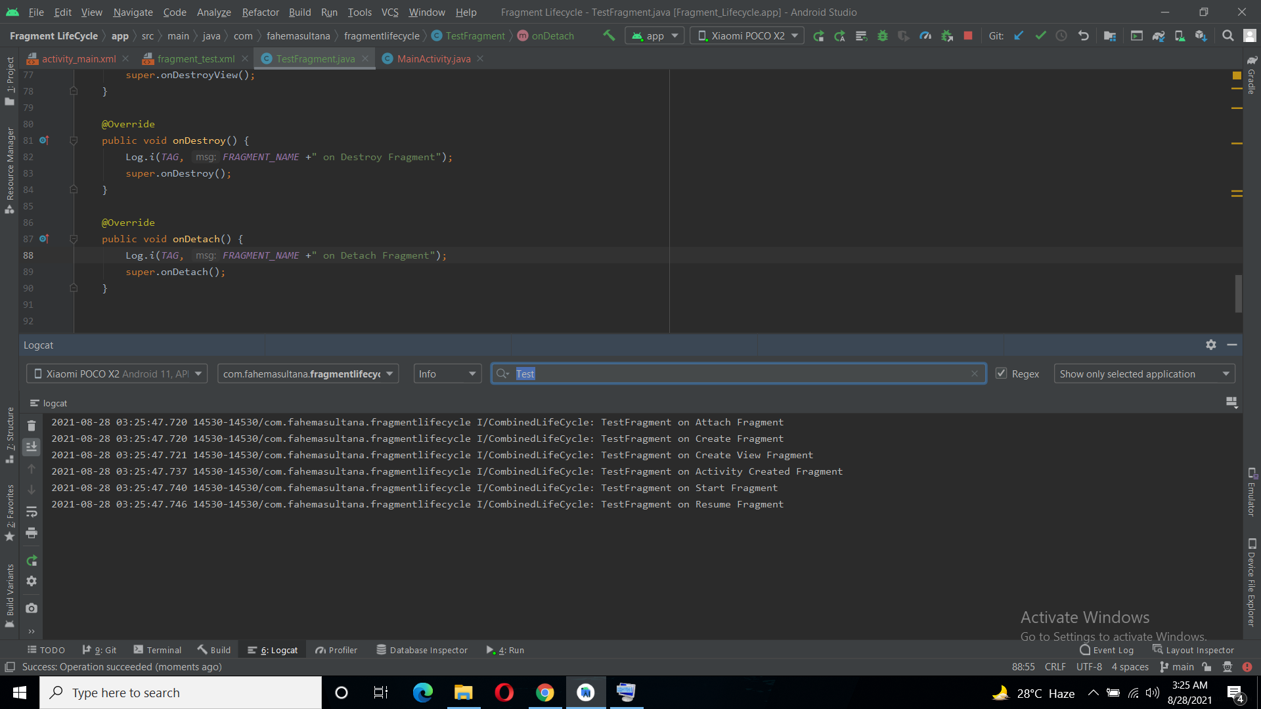
When App is Running Show Fragment Methods

Slide 9
Details of previous Slide
From previous screen shot we can see when App and Fragment is running the fragment methods ; onAttach(), onCreate() ,onCreateView() ,onActivityCreated() ,onStart() ,onResume() method had been called. Here the fragment is visible.

Slide 10
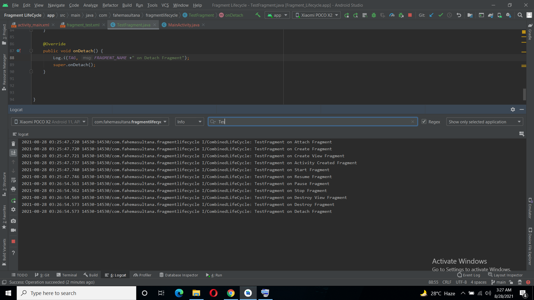
When Stop the Fragment Show Fragment Method

Slide 11
Details of previous Slide
From previous screen shot we can see when stop the Fragment , The fragment Methods onPause(), onStop(), onDestroyView(), onDestroy(), onDetach() method had been called. Here , the fragment is destroy

Slide 12
The Relation Between Fragment And Activity Lifecycle
When Activity Method onCreate() executed , with this the Fragment Method
onAttach()
onCreate()
onCreateView()
onActivityCreated()
Will be executed also.
When Activity Method onStart() executed , with this the Fragment Method onStart() executed.
When Activity Method onResume() executed , with this the Fragment Method onResume() executed.

Slide 13
The Relation Between Fragment And Activity Lifecycle
Here , onCreate() Activity get call first. Then the Fragment will be attach by onAttach() method. Then the on create Fragment create a Fragment using the bundle object by onCreate() method.Then on create View Fragment create the UI of Fragment by onCreateView() method. Then on activity created indicates the onCreate() method of activity was completed by onActivityCreated() methods.
Then on start Activity get called first by onStart() method. Then on start fragment get called by onStart() methods.
Then on resume Activity get called first by onResume() method. Then on Resume fragment get called by onResume() methods.

Slide 14
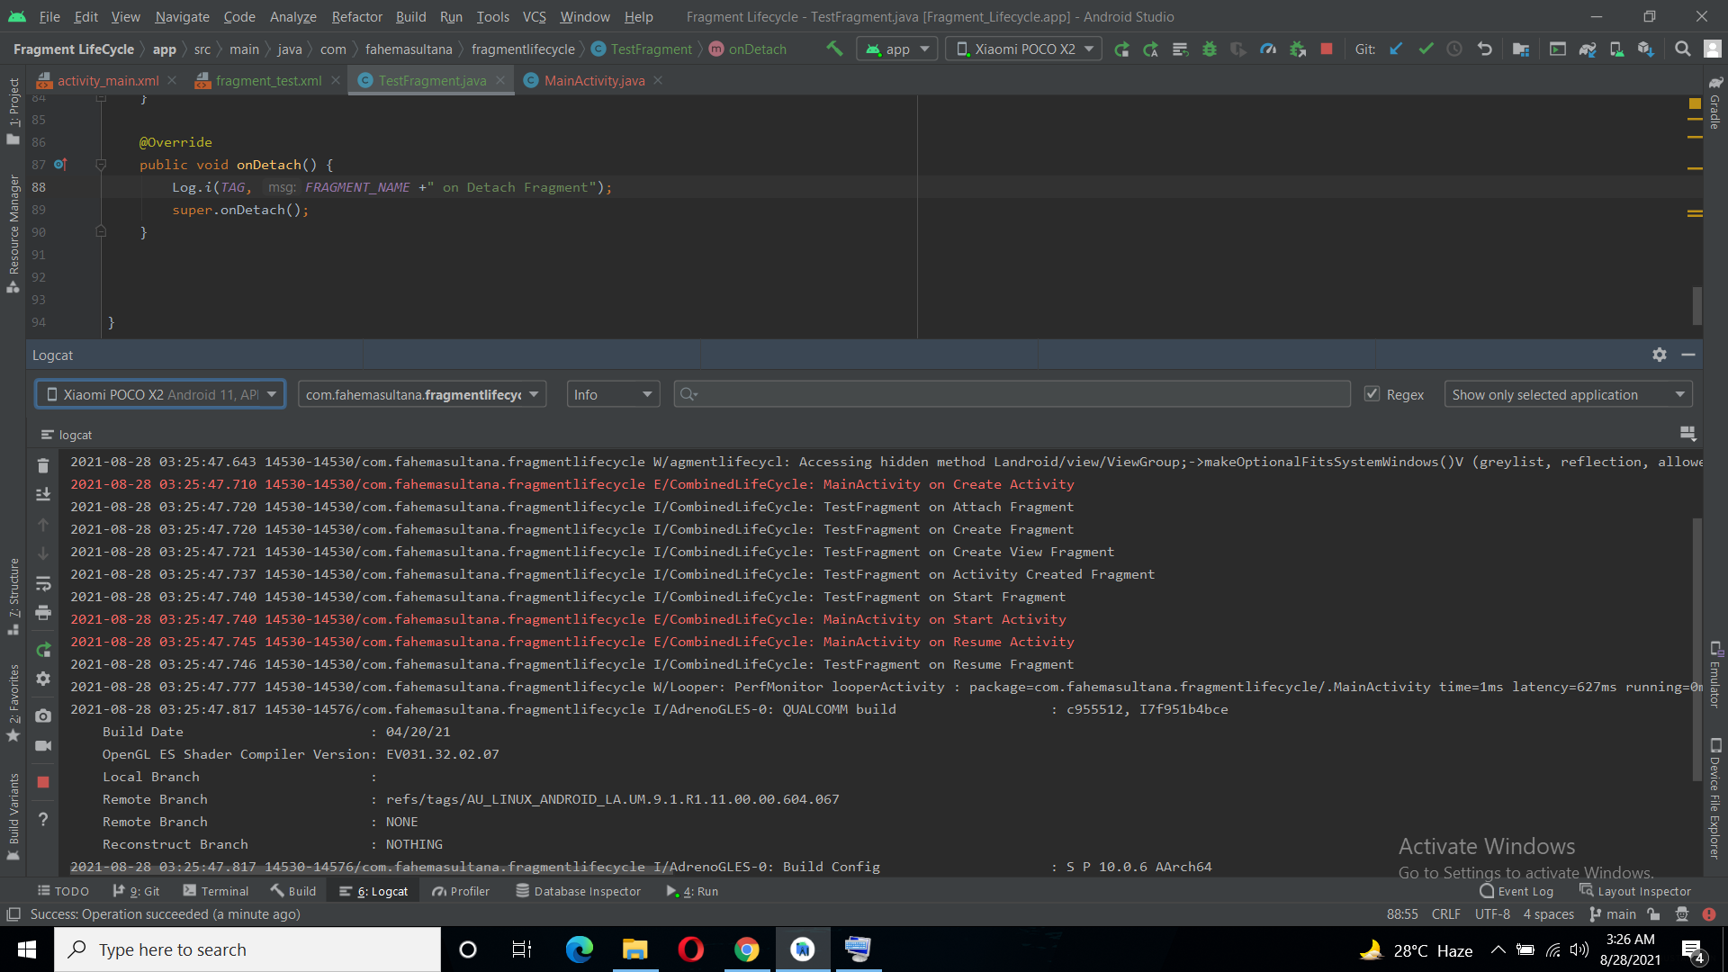
Show the output when the Fragment Running

Slide 15
The Relation Between Fragment And Activity Lifecycle
After press the back button the app stopped the fragment.
Then Execute on pause fragment by onPause() method; then stop the fragment by onStop() method ; then execute on destroy view fragment by onDestroyView() method; then destroy the fragment by onDestroy() method ; then detach the fragment from activity by onDetach() method.
After Stop the App :
Activity was paused by onPaused() method ; then stop the activity by onStop() method ; then destroy the activity by onDestroy() method.

Slide 16
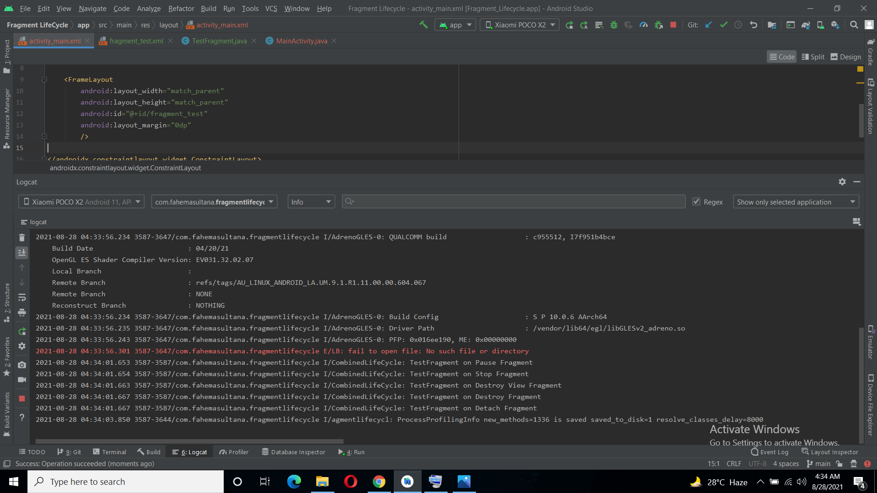
Show the output when the Fragment Stopped

Slide 17
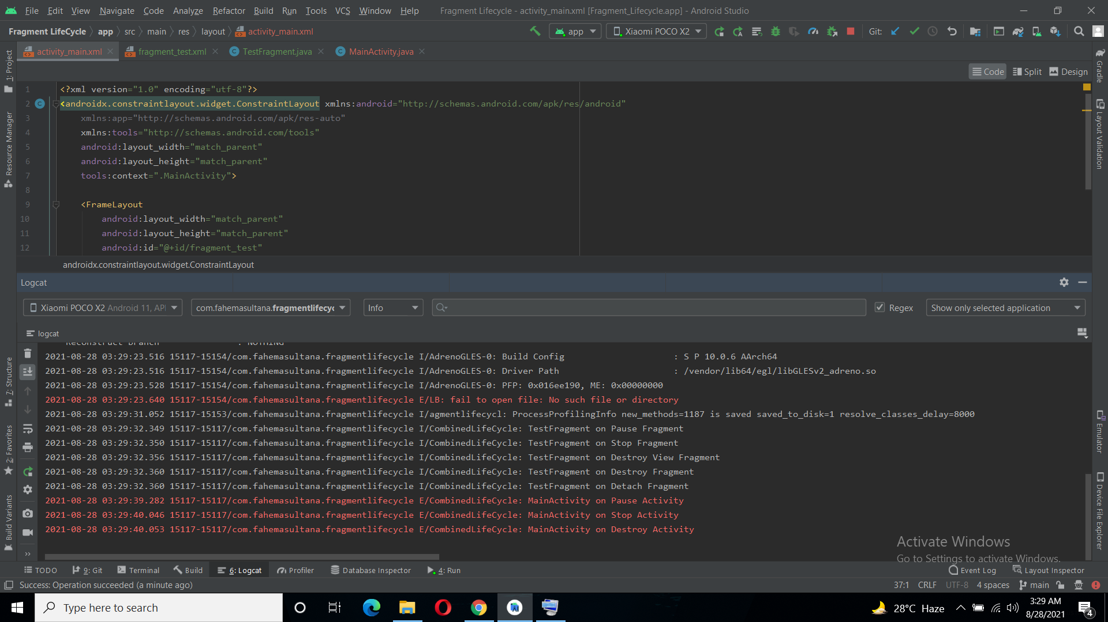
Show the output when the App Stopped

Slide 18
This is the Activity and fragment lifecycle based on my app .
Git link : https://github.com/NSU-SU21-CSE486-1/1711593_SU21_CSE486_1/tree/main/Theory/Midterm/Fragment%20LifeCycle

Slide 19
END

